Slide 1
Employee data analysis using MS Excel
Student Name : Balaji V
Register No. : 312211588
Department : 3rd B.com(G) - A
College : Thiruthangal nadar college

Slide 2
Project Title
Employee performance analysis
By using MS Excel

Slide 3
Agenda
1.Problem statement
2.Project overview
3.End users
4.Our solution and proposition
5.Dataset Description
6.Modelling Approach
7.Results and Discussion
8.Conclusion

Slide 4

Problem statement
The primary objective of this project is to analyze employee performance data using Excel to identify key performance trends, recognize top performers, and highlight areas that require improvement. The analysis will provide actionable insights to enhance overall productivity and support data-driven decision-making in workforce management.The project will deliver a detailed performance analysis report and an interactive Excel dashboard that allows stakeholders to monitor employee performance effectively. The insights gained will help in recognizing top talent, addressing performance gaps, and making informed decisions to boost overall organizational productivity.

Slide 5
Problems to solve
The goal is to develop an Excel-based employee performance analysis system that allows HR managers and team leaders to efficiently gather, consolidate, and analyze performance data. This system should provide clear metrics, visualizations, and automated calculations to enable data-driven decisions, objective evaluations, and effective feedback loops.Performance data is often scattered across different files or platforms, making it difficult to consolidate and analyze effectively.Without clear metrics and visualizations, it’s hard for managers to identify trends or spot underperformance early.

Slide 6
Who are the end users?
Human Resources (HR) Managers
Department Managers/Supervisors
Senior Management/Executives
Employees

Slide 7
Our Solution and its Value propostion
*1. Set Clear Expectations*
*2. Provide Regular Feedback*
*3. Training and Development*
*4. Improve Communications*
*5. Employee Engagement*

Slide 8
Dataset description
1. Employee Information
Employee ID: A unique identifier for each employee.
Name: Employee's full name (often anonymized for privacy).
Department: The department or team the employee is part of.
Position/Title: The job title or role of the employee.
Date of Hire: The date when the employee joined the company.
Supervisor/Manager: The name or ID of the employee's direct supervisor.

Slide 9
Modelling Approaches
Objective DefinitionPurpose: Define the goal of the performance analysis (e.g., improving productivity, identifying training needs, succession planning).
Scope: Determine which employees, departments, or roles will be analysed.
Performance MetricsKey Performance Indicators (KPIs): Select relevant KPIs such as:Task Efficiency: Speed and accuracy of task completion.
Quality of Work: Adherence to standards, error rates.Productivity: Output relative to resources used.
Punctuality and Attendance: Timeliness and attendance records.Customer Satisfaction: Feedback from clients or internal customers.

Slide 10
Some other models
Data CollectionQuantitative Data: Collect numerical data from performance tracking systems (e.g., sales numbers, project completion rates).
Qualitative Data: Gather subjective assessments through performance reviews, 360-degree feedback, self-assessments, and peer evaluations.
Analysis TechniquesComparative Analysis: Compare individual performance against peers, historical performance, or industry benchmarks.
Trend Analysis: Identify patterns or trends in performance over time.
Gap Analysis: Identify the gap between current performance and desired performance levels.
Performance ScoringWeighted Scoring: Assign weights to different KPIs based on their importance to the role or organization.

Slide 11
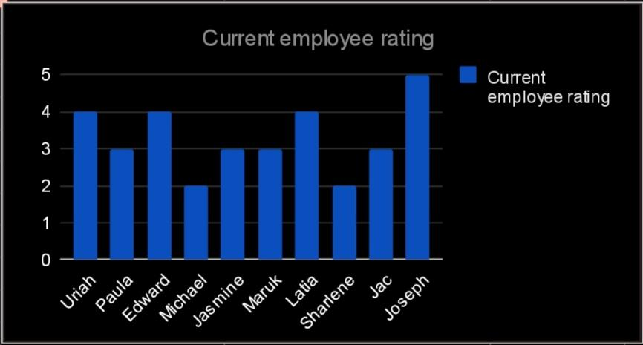
Results in Bar diagram

Slide 12
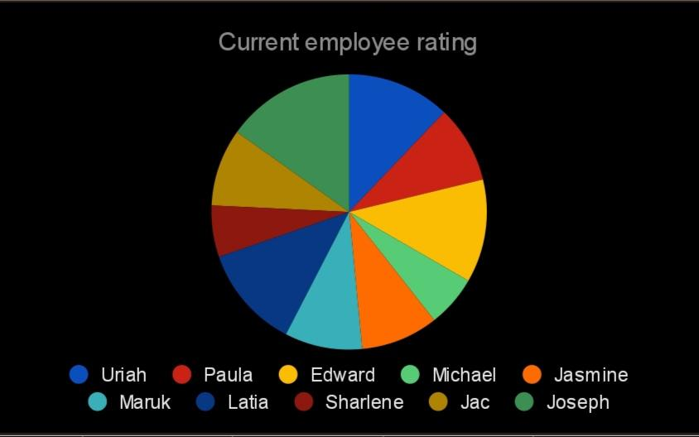
Results in pie chart

Slide 13
Conclusion
In conclusion, the employee performance analysis reveals key insights that can help inform management decisions and drive organizational growth. High-performing employees demonstrate consistent achievements and align well with company goals, suggesting effective utilization of skills and resources. On the other hand, underperforming employees may require targeted development plans, such as training or mentorship, to address gaps in skills or motivation.
Overall, this analysis should be used as a foundation for improving productivity, fostering professional growth, and enhancing team dynamics. By implementing data-driven strategies, the organization can create a more engaged, efficient, and motivated workforce, ultimately leading to better business outcomes.

Slide 14
Thank you.

